Slide 1


Machine Learning Boot camp
Introduction to Data Science

Slide 2
Hello and Welcome
My name is Rajeev Agrawal.
I am super excited to teach you all you need to know about data science and machine learning.
Forbes and Glassdoor ranked Data Scientist as the number one job in America
due to not only the incredible salaries (median base salary of $120,931) for data science positions
but also the chance to solve some of the world's most interesting problems.

Slide 3
Outline
Let's go ahead and take a quick look at the things you'll be learning in this workshop.
You'll start off by learning the basics of R programming including working on vectors, matrices and data frames.
Then you'll learn how to create amazing data visualizations.
Thereafter, you will move onto machine learning.
Exercises and projects.

Slide 4

What is Data Science?
Intersection of fields
Why this explosion:
We live in a data driven world with more data than ever before
Large computing power easily available
New programming tools

Slide 5


Next Step
Download R
Download for RStudio

Slide 6
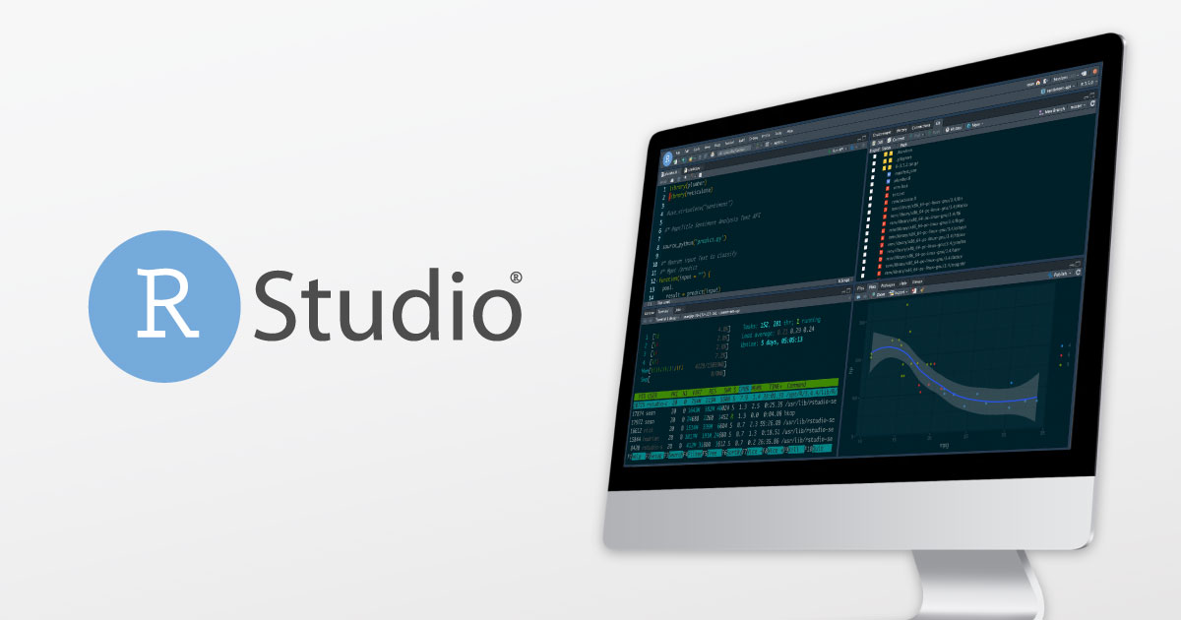
Development Environment Overview

Slide 7
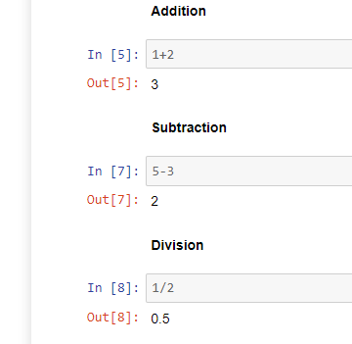
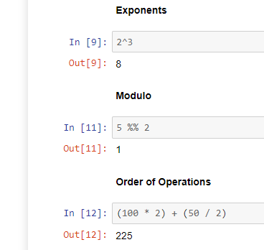
Arithmetic with R

Slide 8
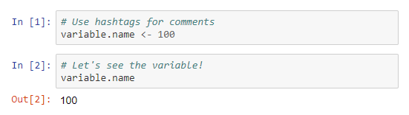
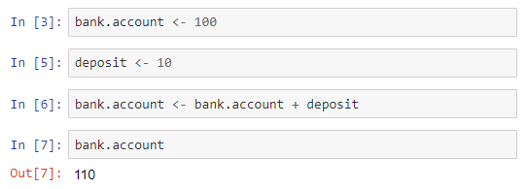
Variables
How to assign variables in R?
We can use variables together and work with them. For example,

Slide 9
R Data Types
Numerics
Decimal (floating point values) are part of the numeric class in R.
Natural (whole) numbers are known as integers are also part of the numeric class.
Logical - Boolean values (True and False) are part of the logical class. In R these are written in All Caps.
Characters - Text/string values are known as characters in R. Use quotation marks (single or double) to create a text character string.
Checking Data Type Classes - The class() function is used to check the data type of a variable.

Slide 10
Vector Basics
You looked at some of the basic data types in R. Now you will learn about one of the key data structures in R, the vector!
A vector is a 1-dimensional array that can hold character, numeric, or logical data elements.
You can create a vector by using the combine function c(). To use the function, we pass in the elements we want in the vector, with each individual element separated by a comma.
Note: We can't mix data types of the elements in an array.

Slide 11
Vector Indexing & Slicing
You can use bracket notation to index and access individual elements from a vector.
Keep in mind index starts at 1 (in some programming languages indexing starts at 0).
Multiple Indexing
You can grab multiple items from a vector by passing a vector of index positions inside the square brackets.
Slicing
You can use a colon (:) to indicate a slice of a vector.
The format is vector[start_index:stop_index] and you will get that "slice" of the vector returned to you.
Indexing with Names
We've seen how we can assign names to the elements in a vector. We can use those names to grab individual elements from the array!

Slide 12
Vector Indexing & Slicing
Comparison Operators and Selection
You can use comparison operators to filter out elements from a vector.
Sometimes this is referred to as boolean/logical masking, because you are creating a vector of logicals to filter out results you want.

Slide 13
R Basics Exercise

Slide 14
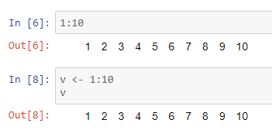
R Matrices
We've learned about vectors which allow us to store indexed elements. A matrix will allow us to have a 2-dimensional data structure which contains elements consisting of the same data type.
Before we talk about the Matrix, we should show a quick tip for quickly creating sequential numeric vectors, you can use the colon notation from slicing to create sequential vectors:

Slide 15
Creating a Matrix
To create a matrix in R, you use the matrix() function. We can pass in a vector into the matrix.
Creating Matrices from Vectors
We can combine vectors to later input them into a matrix.
Naming Matrices
It would be nice to name the rows and columns for reference. We can do this similarly to the names() function for vectors, but in this case we define colnames() and rownames().

Slide 16
Matrix Arithmetic
We can perform element by element mathematical operations on a matrix with a scalar (single number) just like we could with vectors.
Comparison operators with matrices
We can similarly perform comparison operations across an entire matrix to return a matrix of logicals.
Matrix Arithmetic with multiple matrices
We can use multiple matrices with arithmetic as well.

Slide 17
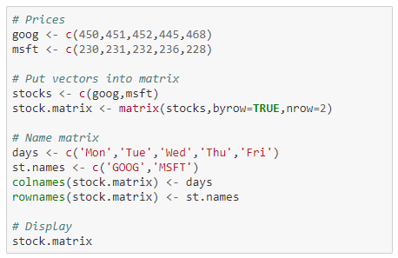
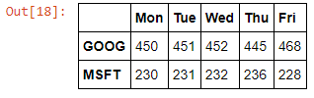
Matrix Operations
Now that we've learned how to create a matrix, let's learn how to use functions and perform operations on it!
Run the following code to create the stock.matrix

Slide 18
Matrix Operations
We can perform functions across the columns and rows, such as
colSums()
rowSums()
rowMeans()
Binding columns and rows
Let's go ahead and see how we can add columns and rows to a matrix, we can use the cbind() to bind a new column, and rbind() to bind a new row.

Slide 19
Matrix Selection & Indexing
Just like with vectors, we use the square bracket notation to select elements from a matrix. Since we have two dimensions to work with, we'll use a comma to separate our indexing for each dimension.
So the syntax is then:
example.matrix[rows,columns]
where the index notation (e.g. 1:5) is put in place of the rows or columns.
If either rows or columns is left blank, then we are selecting all the rows and columns.

Slide 20
R Matrix Exercise

Slide 21
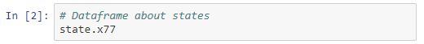
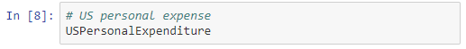
Data Frame Basics
We've learned about vectors and their two-dimensional counterpart, matrices. Now we will learn about Data frames, one of the main tools for data analysis with R!
Matrix inputs were limited because all the data inside of the matrix had to be of the same data type (numerics, logicals, etc). With Data frames we will be able to organize and mix data types to create a very powerful data structure tool!
R actually has built in Data frames for quick reference to play around with!
Check out the following Data frames that are built-in!
To get a list of all available built-in dataFrames, use data()

Slide 22
Working with Data Frames
You'll notice the states Data frame was really big, we can use the head() and tail() functions to view the first and last 6 rows respectively.
Overview of information
We can use the str() to get the structure of a data frame, which gives information on the structure of the data frame and the data it contains, such as variable names and data types.
We can use summary() to get a quick statistical summary of all the columns of a data frame, depending on the data, this may or may not be useful!
Creating Data frames
We can create data frames using the data.frame() function and pass vectors as arguments, which will then convert the vectors into columns of the data frame.

Slide 23
Data Frame Selection & Indexing
We can use the same bracket notation we used for matrices:
df[rows,columns]
Selecting using column names
Here is where data frames become very powerful, we can use column names to select data for the columns instead of having to remember numbers.
If you want all the values of a particular column you can use the dollar sign directly after the dataframe: df.name$column.name
You can also use bracket notation to return a data frame format of the same information.
Filtering with a subset condition
We can use the subset() function to grab a subset of values from our data frame based off some condition.

Slide 24
Data Frame Selection & Indexing
Ordering a Data frame
We can sort the order of our data frame by using the order() function. You pass in the column you want to sort by into the order() function, then you use that vector to select from the data frame.
We can pass a negative sign to do descending order.
We could also use the other column selection method we learned earlier using the $ sign.

Slide 25
Data Frame Operations
Data frames are the workhorse of R, so we will basically be creating a "cheat sheet" of common operations used with data frames and R.
We're going to do an overview of the following common operations:
Creating Data Frames
Importing and Exporting Data
Getting Information about Data Frame
Referencing Cells
Referencing Rows and Columns
Adding Rows and Columns
Setting Column Names
Selecting Multiple Rows
Selecting Multiple Columns
Dealing with Missing Data

Slide 26
R Data Frame Exercise

Slide 27
Data Input and Output with R
CSV Input and Output
CSV stands for comma separated variable and its one of the most common ways we'll be working with data.
The basic format of a csv file is the first line indicating the column names and the rest of the rows/lines being data points separated by commas.
One of the most basic ways to read in csv files in R is to use read.csv() which is built-in to R.
When using read.csv() you'll need to either pass in the entire path of the file or have the file be in the same directory as your R script.

Slide 28
Data Input and Output with R
Excel Files with R
R has the ability to read and write to excel, which makes it very convenient to work on the same datasets as business analysts or colleagues who only know excel, meaning they can work with excel and hand you the files, then you work with them in R!
To do this, we need the readxl package for R. Remember you can download it by using: install.packages('readxl')
You may need to specify repos="http://cran.rstudio.com/" as an argument in the packages call if you get a mirror error.
Writing to Excel
Writing to excel requires the xlsx package.
You may need to use help() to find out additional arguments you may need to get exactly what you want.

Slide 29
Web Scraping with R
Data on the web is growing exponentially.
All of us today use Google as our first source of knowledge – be it about finding reviews about a place to understanding a new term.
With the amount of data available over the web, it opens new horizons of possibility for a data scientist.
That is why, web scraping is an important skill for any data scientist.
In today’s world, all the data that you need is already available on the internet – the only thing limiting you from using it is the ability to access it.
Most of the data available over the web is not readily available. It is present in an unstructured format (HTML format) and is not downloadable. Therefore, it requires knowledge & expertise to use this data.

Slide 30
Web Scraping with R
Web scraping is a technique for converting the data present in unstructured format (HTML tags) over the web to the structured format which can easily be accessed and used.
To fully understand web scraping, you will need to know the
PIPE OPERATOR IN R (%>%)
HTML and CSS in order to know what you are trying to grab off the website
If you don't know HTML/CSS or R, you may be able to use an auto-web-scrape tool, like import.io.
Check it out, it will auto scrape and create a csv file for you.

Slide 31
Web Scraping with R
Prerequisites:
If you are familiar with HTML and CSS a very useful library is rvest.
Data Scientists generally are not very sound with technical knowledge of HTML and CSS. Therefore, we’ll be using an open source software such as Selector Gadget to select the parts of any website and get the relevant tags to get access to that part by simply clicking on that part of the website.

Slide 32
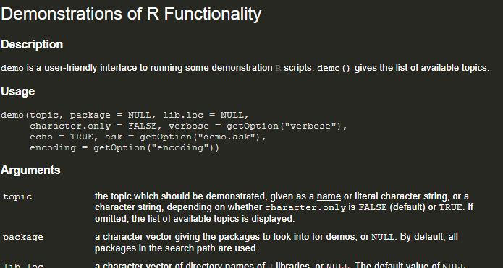
Web Scraping with R
Demo:
??demo
demo(package = 'rvest')
demo(package = 'rvest‘, topic = ‘tripadvisor’)

Slide 33
Web Scraping with R
Web page basics:
HTML (Hyper Text Markup Language) defines the content and structure of a web page. A series of elements, like paragraphs, headers, and tables, make up every HTML page.
The words surrounded by < > are HTML tags. Tags define where an element starts and ends. e.g. paragraph (<p>), headings (<h1>), and tables (<table>).
The HTML contains all the information we’d need if we wanted to read the data into R, but we’ll need rvest to extract the table and turn it into a data frame.
CSS (Cascading Style Sheets) defines the appearance of HTML elements.
CSS selectors are often used to style particular subsets of elements, but you can also use them to extract elements from a web page.

Slide 34
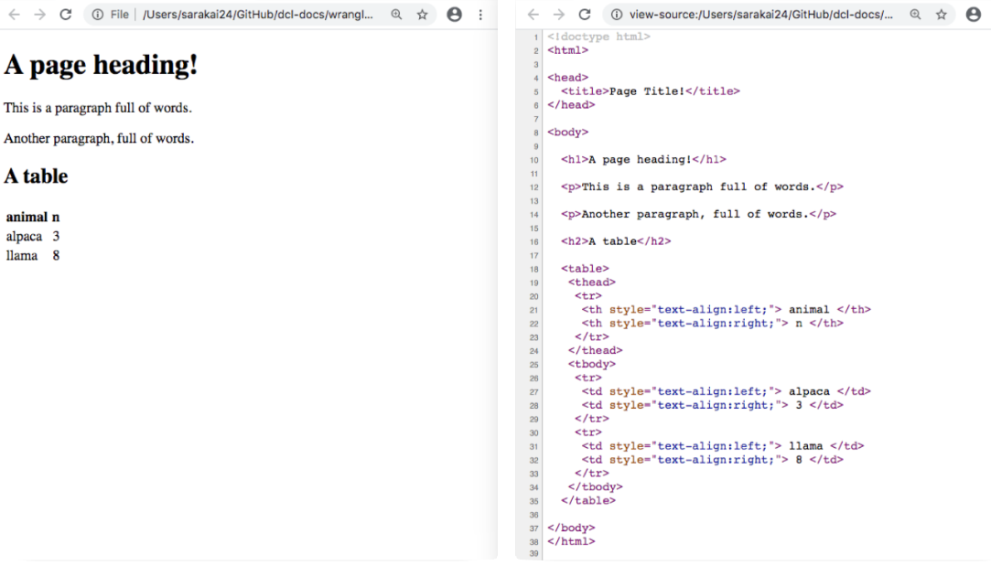
Web Page Basics

Slide 35
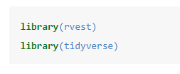
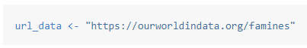
Web Scraping with R
Import the relevant libraries
We will use Our World in Data dataset on world famines available in a tabular form.
Using this table as an example, we’ll show you how to use rvest to scrape a web page’s HTML, read in a particular element, and then convert HTML to a data frame.
Read HTML
First, copy the url of the web page and store it in a parameter.

Slide 36
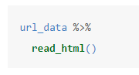
Web Scraping with R
Next, use rvest::read_html() to read all of the HTML into R.
read_html() reads in all the html for the page. The page contains far more information than we need, so next we’ll extract just the famines data table.
Find the CSS selector
We’ll find the CSS selector of the famines table and then use that selector to extract the data.
In Chrome, right click on a cell near the top of the table, then click Inspect (or Inspect element in Safari or Firefox).
Hovering over different HTML elements in the Elements pane will highlight different parts of the web page.
Move your mouse up the HTML document, hovering over different lines until the entire table (and only the table) is highlighted. This will often be a line with a <table> tag.
Right click on the line, then click Copy > Copy selector (Firefox: Copy > CSS selector; Safari: Copy > Selector Path).

Slide 37
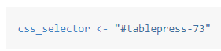
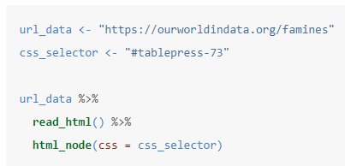
Web Scraping with R
Next, return to RStudio, create a variable for your CSS selector, and paste in the selector you copied.
Extract the table
You already saw how to read HTML into R with rvest::read_html(). Next, use rvest::html_node() to find the first node that matches your CSS selector.

Slide 38
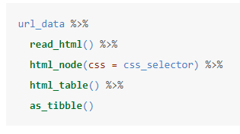
Web Scraping with R
The data is still in HTML. Use rvest::html_table() to turn the output into a data frame. Note that rvest::html_table() returns a data.frame object, not a tibble. To convert it to a tibble, use as_tibble().
Now, the data is ready for wrangling in R.
Note that html_table() will only work if the HTML element you’ve supplied is a table. If, for example, we wanted to extract a paragraph of text, we’d use html_text() instead.

Slide 39
Pipe Operator %>%
The pipe operator is really useful and allows us to chain together multiple operations or functions on a data set.

Slide 40
R Programming Basics

Slide 41
Logical Operators
Logical Operators will allow us to combine multiple comparison operators.
The logical operators we will learn about are:
AND - &
OR - |
NOT - !
Logical Operators with Vectors: We have two options –
a comparison of the entire vectors element by element,
or just a comparison of the first elements in the vectors, to make sure the output is a single Logical. To compare first elements use && or ||

Slide 42
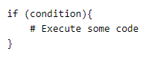
if, else, else if Statements
Now it is time to finally start learning how we can program some sort of logic using R! Our first step in this learning journey for programming will be simple if, else, and else if statements.
Here is the syntax for an if statement in R:
We say if some condition is true then execute the code inside of the curly brackets.
For example, let's say we have two variables, hot and temp. Imagine that hot starts off as FALSE and temp is some number in degrees. If the temp is greater than 80 than we want to assign hot==TRUE.

Slide 43
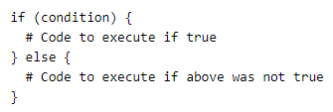
if, else, else if Statements
If we want to execute another block that occurs if the if statement is false, we can use an else statement to do this! It has the syntax:
What if we wanted more options to print out, rather than just two, the if and the else?
This is where we can use the else if statement to add multiple condition checks, using else at the end to execute code if none of our conditions match up with and if or else if.

Slide 44
Conditional Statements
Exercise

Slide 45
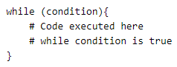
while Loops
while loops are a while to have your program continuously run some block of code until a condition is met (made TRUE). The syntax is:
A major concern when working with a while loop is to make sure that at some point the condition should become true, otherwise the while loop will go forever!
Remember you can use Crtl-C to kill a process in R Studio!

Slide 46
while Loops
You can use break to break out of a loop.
Previously we showed an if statement checking for 10, but this wasn't actually stopping the loop.

Slide 47
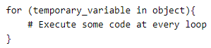
for Loops
A for loop allows us to iterate over an object (such as a vector) and we can then perform and execute blocks of codes for every loop we go through. The syntax for a for loop is:
For loop over a vector
We can think of looping through a vector in two different ways; the first way would be to create a temporary variable with the use of the in keyword.
The other way would be to loop a numbered amount of times and then use indexing to continually grab from the vector.
For loop with a matrix
We can similarly loop through each individual element in a matrix.

Slide 48
for Loops
Nested for loops
We can nest for loops inside one another.
However be careful when doing this, as every additional for loop nested inside another may cause a significant amount of additional time for your code to finish executing.

Slide 49
Functions
Functions will be one of our main building blocks when we construct larger and larger amounts of code to solve problems.
So what is a function?
It is a useful tool that groups together a set of statements so they can be run more than once.
They can also let us specify parameters that can serve as inputs to the functions.
Functions will be one of most basic levels of reusing code in R, and it will also allow us to start thinking about program design.
We already have seen built-in functions and we can use the help function to discover the arguments that the functions take in.

Slide 50
Functions
Default values
Notice that so far we've had to define every single argument in the function when using it, but we can also have default values by using an equals sign.
Returning Values
So far we've only been printing out results, but what if we wanted to return the results so that we could assign them to a variable, we can use the return keyword for this task.

Slide 51
Functions
Scope
Scope is the term we use to describe how objects and variable get defined within R. When discussing scope with functions, as a general rule we can say that if a variable is defined only inside a function than its scope is limited to that function.

Slide 52
Built-in R Functions
Data Structures
R contains quite a few useful built-in functions to work with data structures. Here are some of the key functions to know:
seq(): Create sequences
sort(): Sort a vector
rev(): Reverse elements in object
str(): Show the structure of an object
append(): Merge objects together (works on vectors and lists)
Data Types
is.*(): Check the class of an R object
as.*(): Convert R objects

Slide 53
Built-in R Functions
Mathematical
We've talked a bit about some of the built-in mathematical functions and features in R, but let's have one more look at a few of them:
abs(): computes the absolute value.
sum(): returns the sum of all the values present in the input.
mean(): computes the arithmetic mean.
round(): rounds values (additional arguments to nearest)
sqrt(): computes the square root.
exp(): computes the exponential.

Slide 54
R Functions Exercise

Slide 55
Advanced R Programming

Slide 56
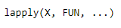
Apply
There are actually quite a few different apply() type functions in R. We will learn about 2 different apply() functions.
The basic idea of an apply() is to apply a function over some iterable object.
Let's start with lapply():
lapply() will apply a function over a list or vector:
where X is your list/vector and FUN is your function.

Slide 57
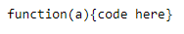
Apply
Anonymous Functions
So you noticed that in the last example we had to write out an entire function to apply to the vector, but in reality that function is just doing something pretty simple, adding a random number. Do we really want to have to formally define an entire function for this? We don't want to, especially if we only plan to use this function a single time!
To address this issue, we can create an anonymous function (called this because we won't ever name it).
Here's the syntax for an anonymous function in R:

Slide 58
Apply
sapply() vs. lapply()
Notice that lapply returned a list. We can use sapply, which simplifies the process by returning a vector or matrix.
sapply() limitations
sapply() won't be able to automatically return a vector if your applied function doesn't return something for all elements in that vector.

Slide 59
Regular Expressions
Regular expressions is a general term which covers the idea of pattern searching, typically in a string (or a vector of strings).
For now we'll learn about two useful functions for regular expressions and pattern searching:
grepl(), which returns a logical indicating if the pattern was found
grep(), which returns a vector of index locations of matching pattern instances
For both of these functions you'll pass in a pattern and then the object you want to search.

Slide 60
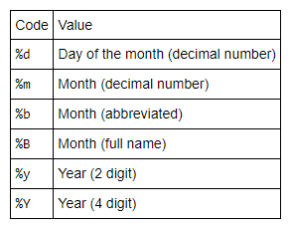
Timestamps
R gives us a variety of tools for working with timestamp information.
Dates
We can ask for today's date by asking the system using Sys.Date() function
You can convert character strings in R to a Date object using as.Date(). You'll need to make sure its in the correct format, or use % symbols that correlate with your given format:
Time
Just like with Dates, we can also convert strings and work with them for time information.
Most times, we'll actually be using the strptime() function.

Slide 61
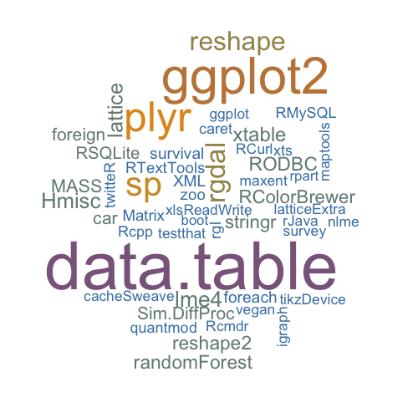

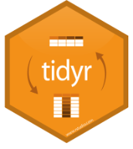
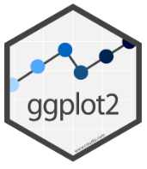
R Packages
https://rstudio.com/products/rpackages/

Slide 62
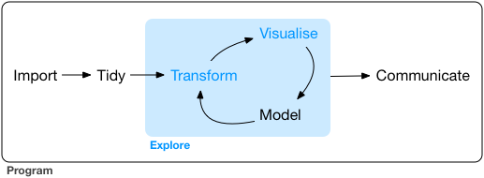
Introduction
The goal of data exploration is to generate many promising leads that you can later explore in more depth.

Slide 63
Dplyr Package
Manipulating Data
We'll be covering the following functions:
filter() allows you to select a subset of rows in a data frame.
slice() allows us to select rows by position.
arrange() works similarly to filter() except that instead of filtering or selecting rows, it reorders them.
select() (and rename()): Often you work with large datasets with many columns but only a few are actually of interest to you. select() allows you to rapidly zoom in on a useful subset using operations that usually only work on numeric variable positions.
distinct() returns the unique values in a table.

Slide 64
Dplyr Package
Manipulating Data
Some more functions:
mutate() and transmute(): Besides selecting sets of existing columns, it’s often useful to add new columns that are functions of existing columns. This is the job of mutate(). Use transmute if you only want the new columns.
summarise() quickly collapses data frames into single rows using functions that aggregate results. Remember to use na.rm=TRUE to remove NA values.
sample_n() and sample_frac() can be used to take a random sample of rows: use sample_n() for a fixed number and sample_frac() for a fixed fraction.

Slide 65
Dplyr Exercise

Slide 66
Tidyr Package
Cleaning Data
Hopefully you've seen how dplyr() can save you lots of time and headaches! Remember to use help() if you ever need help using the package.
Now we can begin to learn about tidyr which is a complementary package that will help us create tidy data sets!
So what do we mean when we say "tidy data"?
Tidy data is when we have a data set where every row is an observation and every column is a variable, this way the data is organized in such a way where every cell is a value for a specific variable of a specific observation. Having your data in this format will help build an understanding of your data and allow you to analyze or visualize it quickly and efficiently.

Slide 67
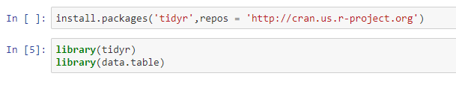
Tidyr Package
Cleaning Data
Installing tidyr
Data.frames vs. data.tables
Loosely speaking, you can think of data.tables as data.frames with extra features.
data.frame is part of base R.
data.table is a package that extends data.frames.
Two of its most notable features are speed and cleaner syntax.

Slide 68
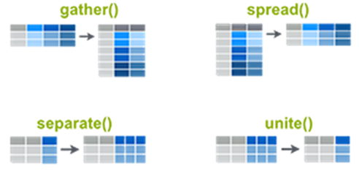
Tidyr Package
Cleaning Data
We'll be covering the following functions:
gather() collapses multiple columns into key-pair values.
spread() reverse of gather().
separate() separates one column into multiple columns.
unite() reverse of separate().

Slide 69
Dplyr and Tidyr Packages
Cheat Sheet

Slide 70
Ggplot2 Package
Data Visualization
ggplot2 is an enhanced data visualization package for R, which creates stunning multi-layered graphics with ease.
It is one of the most common and popular libraries for data visualization in R.
It was created by Hadley Wickham.
He is a statistician from New Zealand who is currently Chief Scientist at RStudio and an adjunct Professor of statistics at the University of Auckland, Stanford University, and Rice University.
He also created packages like Dplyr and Tidyr.
It follows a distinct Grammar of Graphics philosophy.
Built on the idea of adding layers to your visualization.
We can get a better understanding through some quick examples.

Slide 71

Ggplot2 Package
Data Visualization
The first 3 layers are the most basic:
Data is a data frame
Aesthetics is used to indicate x and y variables. It can also be used to control the color, the size or the shape of points, the height of bars, etc…..
Geometries define the type of graphics (histogram, box plot, line plot, density plot, dot plot, ….)
Plot = Data + Aesthetics + Geometry.

Slide 72
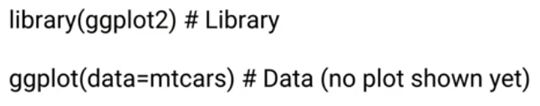
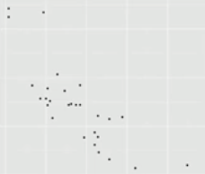
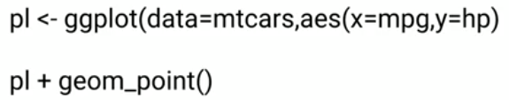
Ggplot2 Package
Data Visualization
Step 1
Step 2
Step 3: Will actually see some output!

Slide 73

Ggplot2 Package
Data Visualization
Next 3 layers to customize our data visualization:
Facets
Statistics
Coordinates

Slide 74
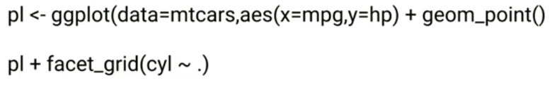
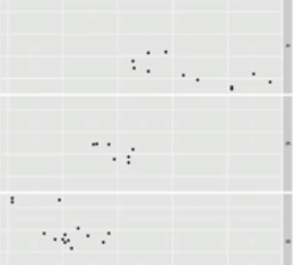
Ggplot2 Package
Data Visualization
Facets: Allows us to put multiple plots on next to each other, these plots are usually related by the same dataset.

Slide 75
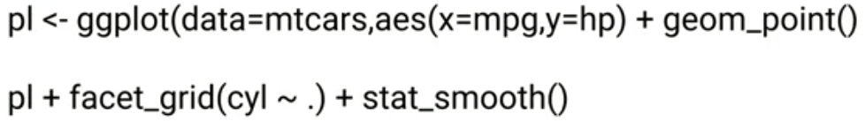
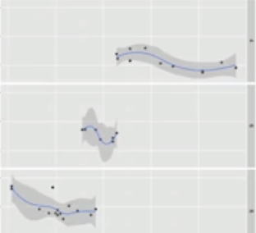
Ggplot2 Package
Data Visualization
Statistics

Slide 76
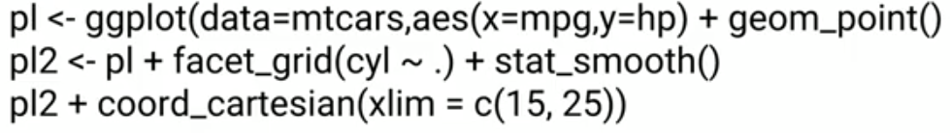
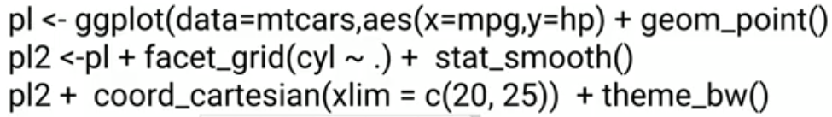
Ggplot2 Package
Data Visualization
Coordinates: Learning how to deal with coordinates will allow us to size our plots correctly.
Themes

Slide 77
Ggplot2 Package
What have we learned?
ggplot2 has a lot of options for plot types!
The main idea is to add layers together.
Let us now discover how to create data visualizations!
Scatterplots
Histograms
Barplots
Boxplots
Variable Plotting

Slide 78
Ggplot2 Package
Data Visualization
There are two major functions in ggplot2 package: qplot() and ggplot() functions.
qplot() stands for quick plot, which can be used to produce easily simple plots.
ggplot() function is more flexible and robust than qplot for building a plot piece by piece.

Slide 79
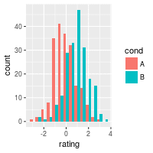
Ggplot2 Package
Histograms
A histogram is a graphical display of data using bars of different heights. In a histogram, each bar groups numbers into ranges.
Taller bars show that more data falls in that range.
To construct a histogram, the first step is to "bin" (or "bucket") the range of values—that is, divide the entire range of values into a series of intervals—and then count how many values fall into each interval. The bins are usually specified as consecutive, non-overlapping intervals of a variable. The bins (intervals) must be adjacent, and are often (but not required to be) of equal size.

Slide 80

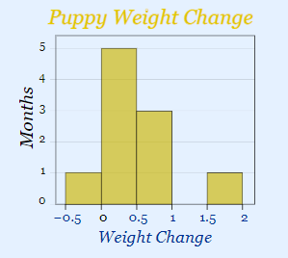
Histogram Example
How much is that puppy growing?
Each month you measure how much weight your pup has gained and get these results:
0.5, 0.5, 0.3, −0.2, 1.6, 0, 0.1, 0.1, 0.6, 0.4
They vary from −0.2 (the pup lost weight that month) to 1.6
Put in order from lowest to highest weight gain:
−0.2, 0, 0.1, 0.1, 0.3, 0.4, 0.5, 0.5, 0.6, 1.6
You decide to put the results into groups of 0.5:
The −0.5 to just below 0 range,
The 0 to just below 0.5 range,
etc...

Slide 81
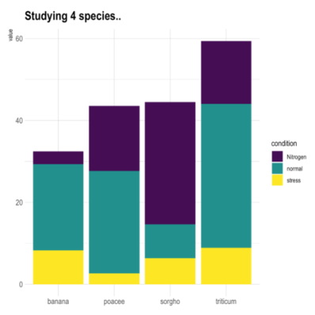
Ggplot2 Package
Barplots
Barplots are a useful way of displaying occurrence counts when a histogram isn't quite what you're looking for!
In ggplot2, there are two types of bar charts, determined by what is mapped to bar height. By default, geom_bar uses stat="count" which makes the height of the bar proportional to the number of cases in each group (or if the weight aesthetic is supplied, the sum of the weights).
If you want the heights of the bars to represent values in the data, use stat="identity" and map a variable to the y aesthetic.

Slide 82
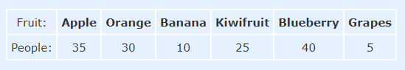
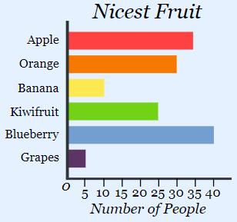
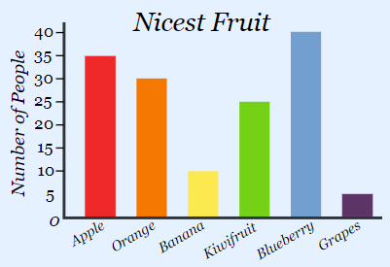
Barplot Example
Nicest Fruit?
A survey of 145 people asked them "Which is the nicest fruit?“:
That group of people think Blueberries are the nicest.

Slide 83
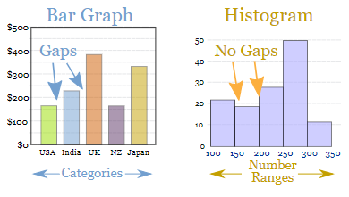
Histograms vs. Barplot
Bar Graphs are good when your data is in categories (such as "Comedy", "Drama", etc).
But when you have continuous data (such as a person's height) then use a Histogram.
It is best to leave gaps between the bars of a Bar Graph, so it doesn't look like a Histogram.

Slide 84
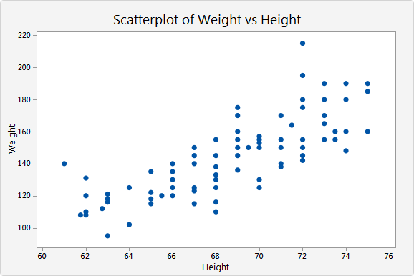
Ggplot2 Package
Scatterplots
A scatterplot is a type of data display or mathematical diagram using Cartesian coordinates that typically shows the relationship between two numerical variables.
Each member of the dataset gets plotted as a point whose ( x , y ) where x and y relates to its values for the two variables.

Slide 85
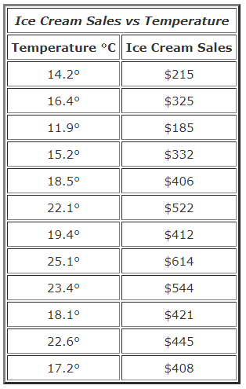
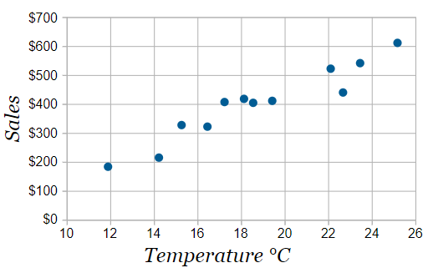
Scatterplot Example
The local ice cream shop keeps track of how much ice cream they sell versus the noon temperature on that day. Here are their figures for the last 12 days:
It is now easy to see that warmer weather leads to more sales, but the relationship is not perfect.

Slide 86

Line of Best Fit
Try to have the line as close as possible to all points, and as many points above the line as below.

Slide 87

Ggplot2 Package
Boxplots
Boxplots are convenient way of graphically depicting groups of numerical data through their quartiles.
Box plots may also have lines extending from the boxes (whiskers) indicating variability outside the 1st and 3rd quartiles, hence the term box-and-whisker plot/diagram is also used.
Outliers may be plotted as individual points.

Slide 88

Boxplot Example
A sample of 10 boxes of raisins has these weights (in grams):
30, 38, 25, 28, 29, 37, 29, 34, 35, 35
Step 1: Order the data from smallest to largest.
Step 2: Find the median.
Step 3: Find the quartiles.
Step 4: Complete the five-number summary by finding the min and the max.
The five-number summary divides the data into sections that each contain approximately 25% of the data in that set.

Slide 89

Ggplot2 Package
2 Variable Plotting
We will briefly show some examples of how you can compare two variables from a dataset.

Slide 90
Ggplot2 Package
Data Visualization
Coordinates and Faceting
Themes
Cheat sheet

Slide 91

Plotly Package
plotly is an R package for creating interactive web-based graphs via plotly's JavaScript graphing library, plotly.js.
The plotly R library contains a function ggplotly which will convert ggplot2 figures into graphs drawn with plotly.js.

Slide 92
Ggplot2 Exercise

Slide 93
Data Visualization Project

Slide 94
Summary
What is data science?
R Data Types
Vectors, matrices and data frames
Data input and output with R
Programming in R
Functions
R Packages
Dplyr for data manipulation
Tidyr for data cleaning
Ggplot2 and Plotly for data visualization

Slide 95

Machine Learning
http://faculty.marshall.usc.edu/gareth-james/ISL/

